Slide 1

Five Ways to Improve Your Web Map
2013 Esri International User Conference
July 8–12, 2013 | San Diego, California
Technical Workshop
Jim Herries
Notes:
This template is based on
Esri Corporate Template
v1.1, March 7, 2013
See http://arczone/resources/presentations.cfm for more sample files and help.

Slide 2
Five Seven Ways to Improve Your Web Map
Get the basemap right.
Give your map a human-readable title
Write human-readable description and summary
Set the “first impression” map extent & save - try different scales, areas, choose something engaging
Turn your basic popup into a great popup:
Ask the data expert what the basic popup tells them
Write down the answer - that's your popup
Usually, you find out you need 1-2 more pieces of info
Put the web map in a simple web app and *share* that with your test subjects to gain reactions
Make GREAT thumbnails for your items

Slide 3
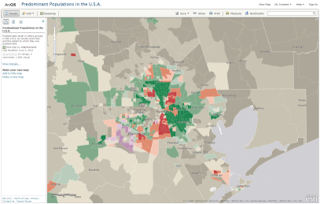
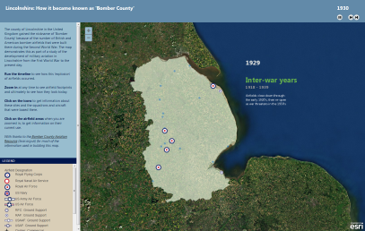
Click to view examples shown

